Slide 1
Dictionary Management System (DMS)
Allan Yang 2012.06.05

Slide 2
AGENDA
Problem
Goal
DMS
Roles & Features
Use Cases

Slide 3
Background Current situation
xdct
Send
xdct
Send
xdct
GTT
Receive
Merge
properties
properties
properties
Notepad
xml
xml
xml
Trados
……
……
……
xmldict
Application Owner
Translation Manager
Translator

Slide 4
Background
Problems
Variety of application dictionaries and tools:
- Too many different file format (dct, xml, properties, …)
- Too many different translation tools (GTT, DMT, xmldict, trados, notepad…)
- Inconsistent definition of language code (e.g. US0 / en_US / us)
- Different encoding/charset (ASCII, UTF-8, UTF-16, non-unicode codepage for different language)
- Dictionaries are not shared, same texts are translated for several times
For translator:
- Not easy to locate the texts in dictionary file which need translation
- Encoding could be easily changed, dictionary files even corrupted
For translation manager:
- Time-consuming to count, verify and merge translations manually
- Easy to make mistakes
A lot of time & money have been wasted!

Slide 5
The Goal
Improve efficiency of translation procedure
Reduce manual processing as much as possible
Be able to deliver the translation faster
Ensure a high quality translation result
Share translations between different products
Improve the QCCD of the translation work

Slide 6
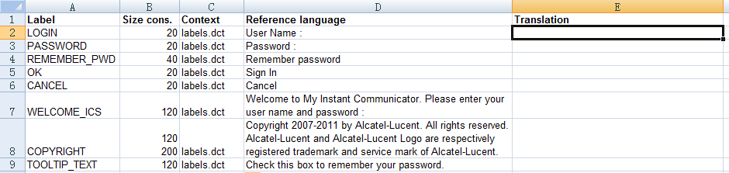
DMS Introduction
Dictionary Management System (DMS) is a unified dictionary & translation management tool for ALE products.
xdct
properties
Import
(All in Unicode)
Download
xls
xml
Upload
Excel
……
DMS
Export
Application Owner
Translation Manager
Translator

Slide 7
Benefits
Easy to manage dictionaries
Compatible with current dictionary format
Support dictionary format transformation
Easy to pick out texts to be translated
Unified excel file for translation
Incremental translation for file update
Easy to add new languages
Translation status tracking and report
Easy to merge translations
On demand generation of dictionaries
Possible to reuse existing translations
Context and version management

Slide 8
Roles & Features System roles
Application owner
Manage applications/dictionaries
Deliver original application dictionaries
Translation manager
Manage products/applications/dictionaries
Manage translation tasks
System administrator
Manage users and privileges
Maintain language master data
Generate application dictionaries
Monitor translation status
Power user
Send for translation/Receive from translation
Translation manager
Manage applications/dictionaries
System administrator

Slide 9
Access Control
Functionality | Application owner | Translation manager | System admin
Manage product/version |  | Y | Y
Manage application/dictionary | Y | Y | Y
Deliver application dictionary | Y |  | Y
Generate application dictionary | Y | Y | Y
Create translation task |  | Y | Y
Send for translation |  | Y | Y
Receive translation |  | Y | Y
Generate translation summary report | Y | Y | Y
Add new language to dictionary | Y | Y | Y
Access control |  |  | Y
Language code&charset definition |  |  | Y

Slide 10
Manage language code/charset
Manage users
System Administration
Modules
Merge translation results into dictionary
Download & Upload translation tasks (Excel)
Translation Taskboard
Translation Management
Import application dictionaries (dct, xml, properties, dictionary.conf)
Manage Products/Applications
Application Management
Create translation tasks
Manage translation status
Verify translation results
Export translated application dictionaries (dct, xml, properties, dictionary.conf)

Slide 11
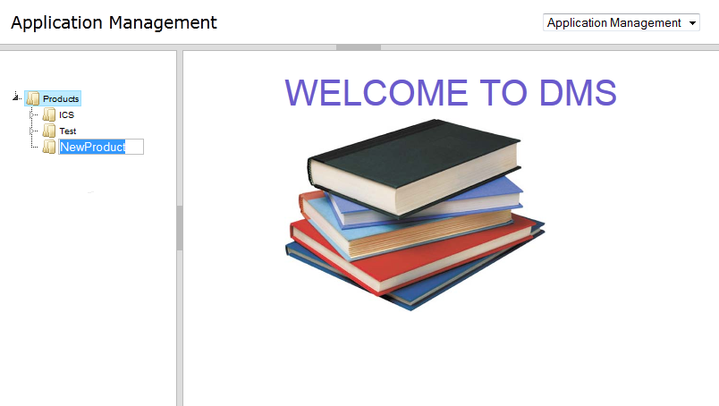
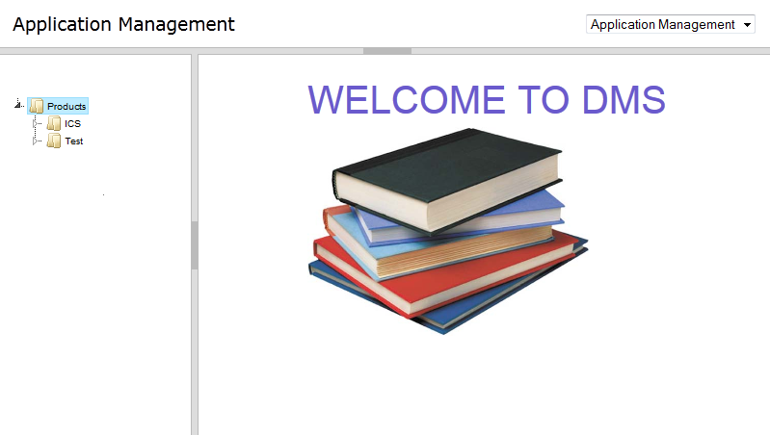
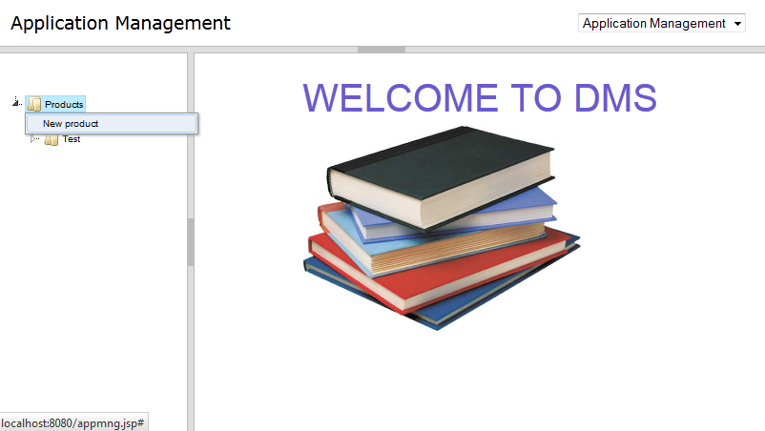
Use Cases Create a product or application

Slide 12
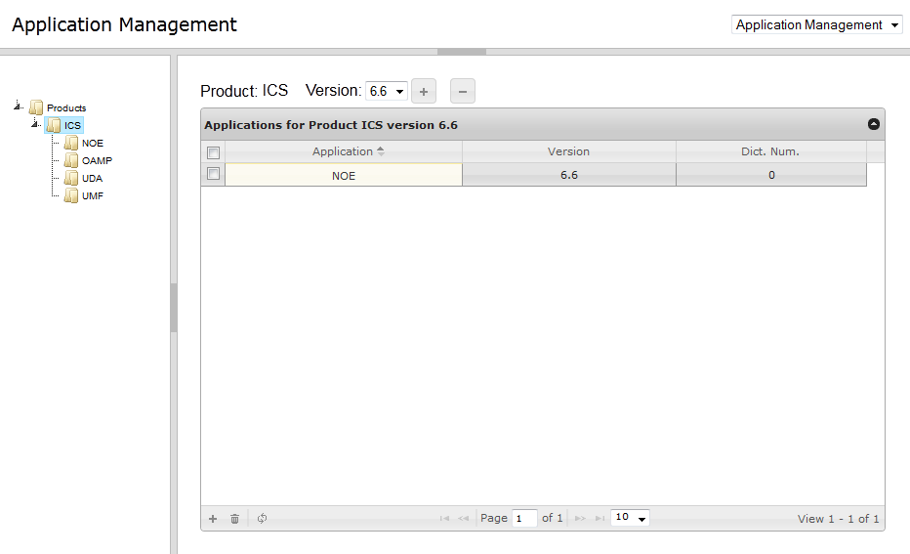
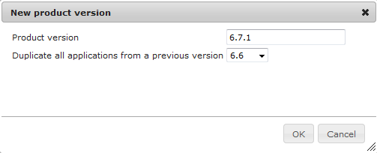
Use Cases
Add a version

Slide 13
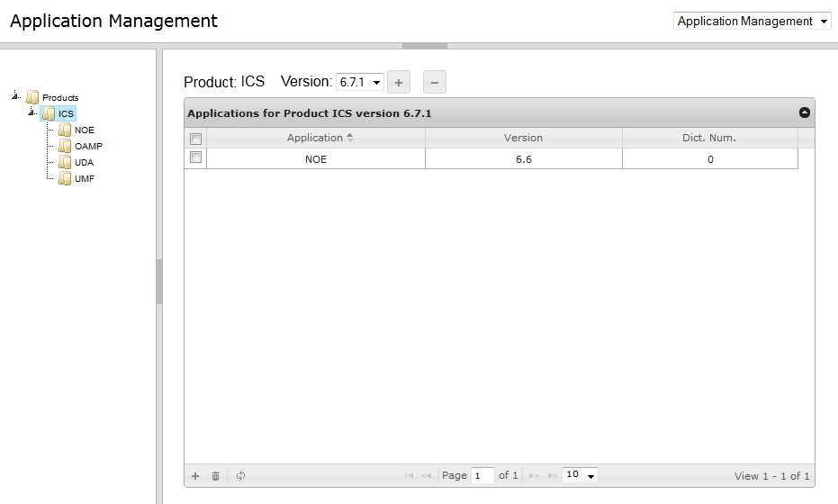
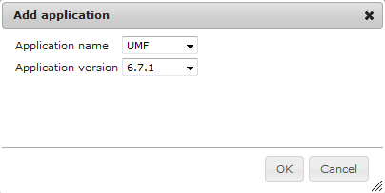
Use Cases
Add applications to a product

Slide 14
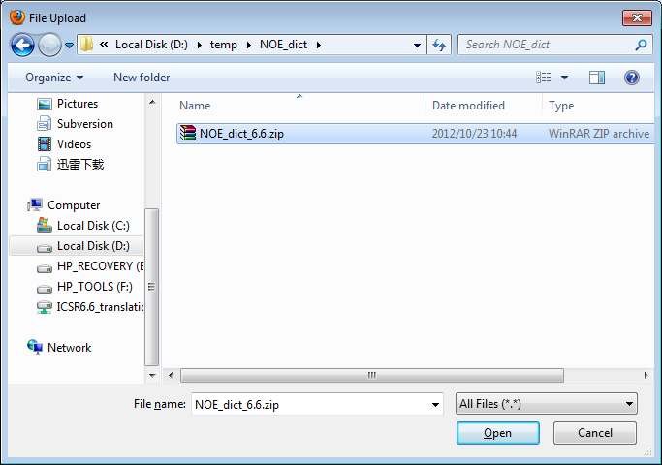
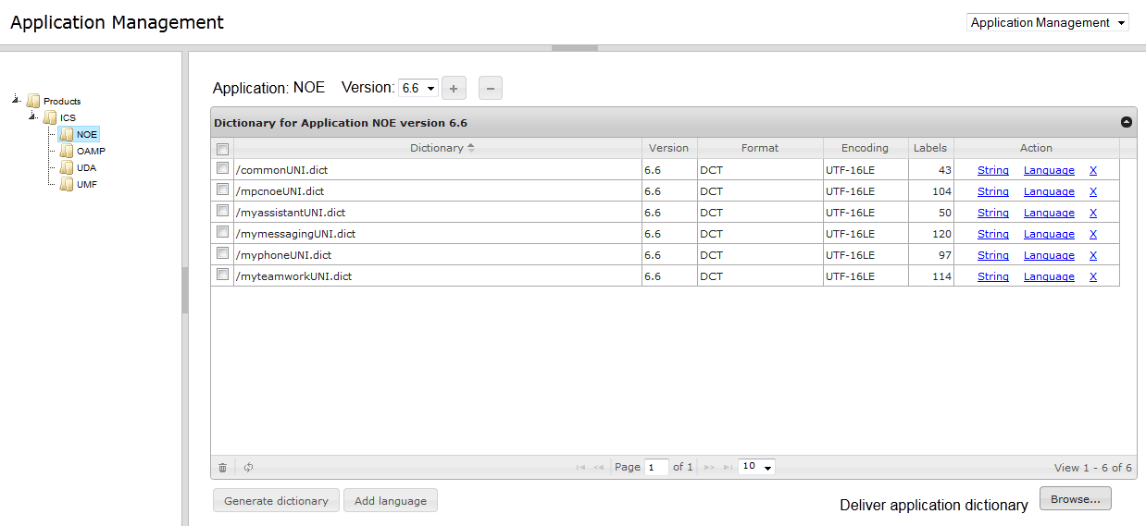
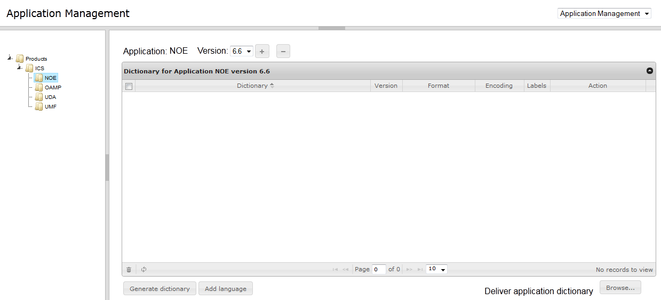
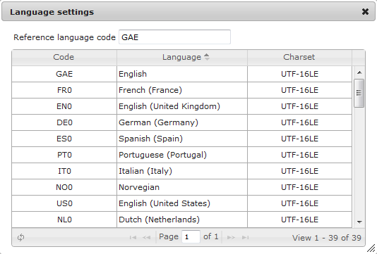
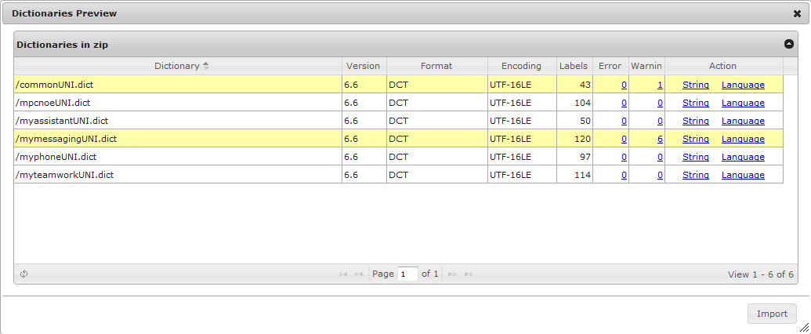
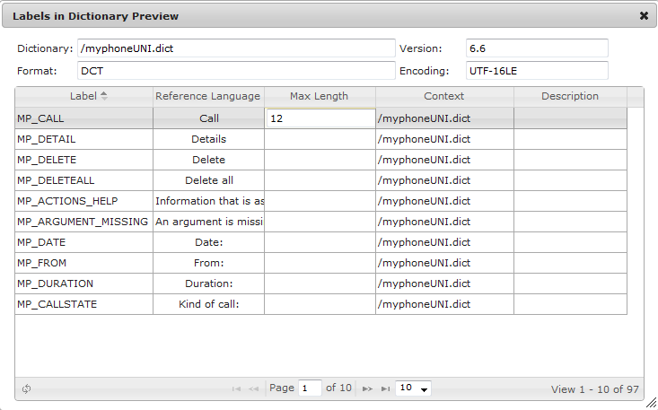
Use Cases
Deliver application dictionaries

Slide 15
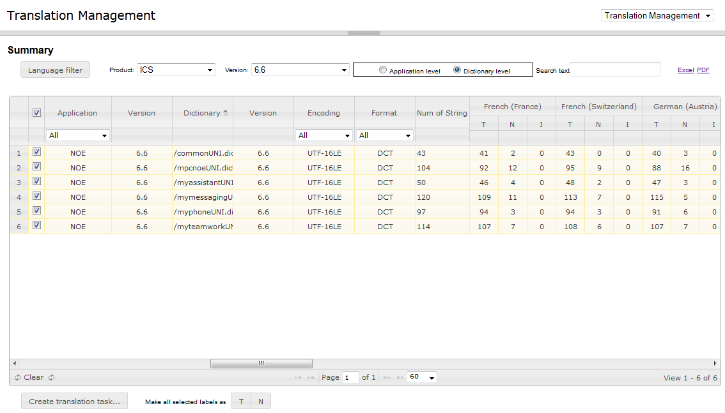
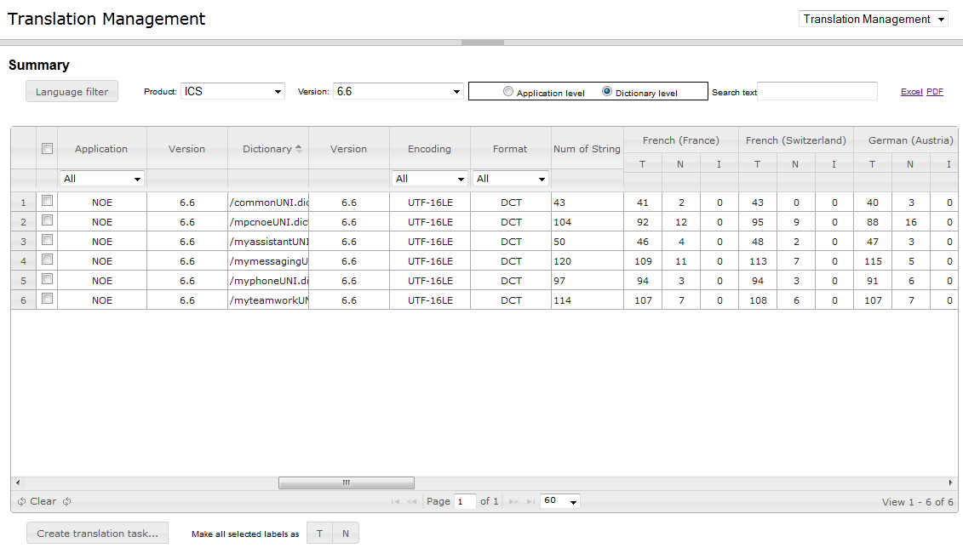
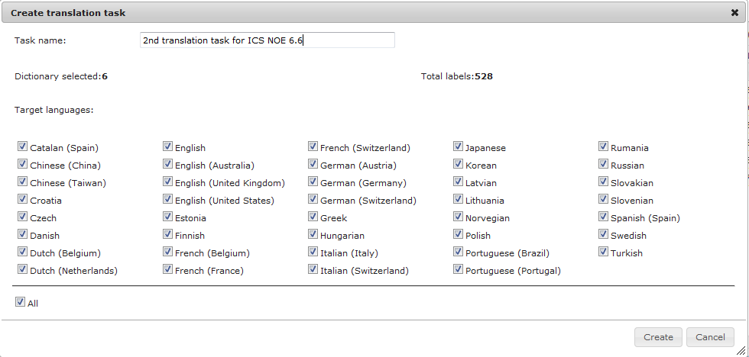
Use Cases
Create a translation task

Slide 16
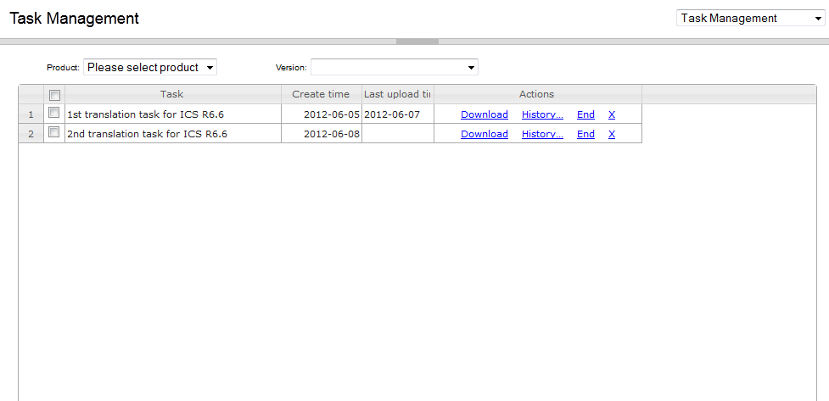
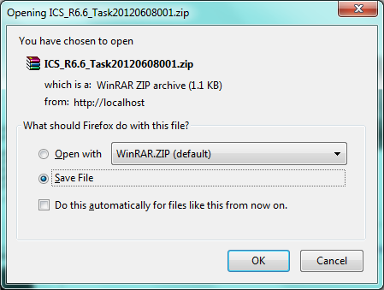
Use Cases
Send for translation

Slide 17
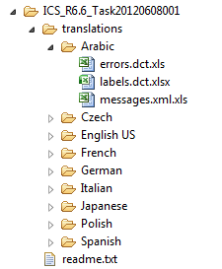
Use Cases
Send for translation
Structure of the zip file:
There is one Excel for each context in each language.

Slide 18
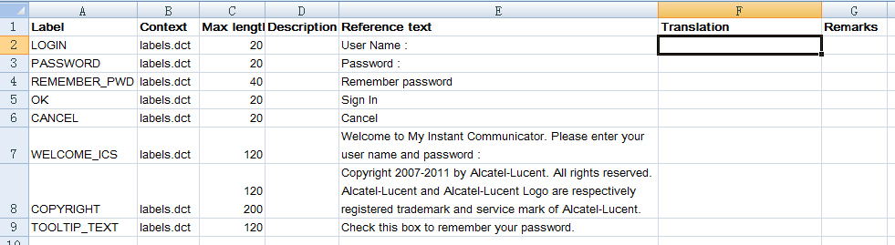
Use Cases
Send for translation
Content of Excel file (e.g. labels.dct.xls):
Translator is responsible to fill in column “Translation” with translation result.

Slide 19
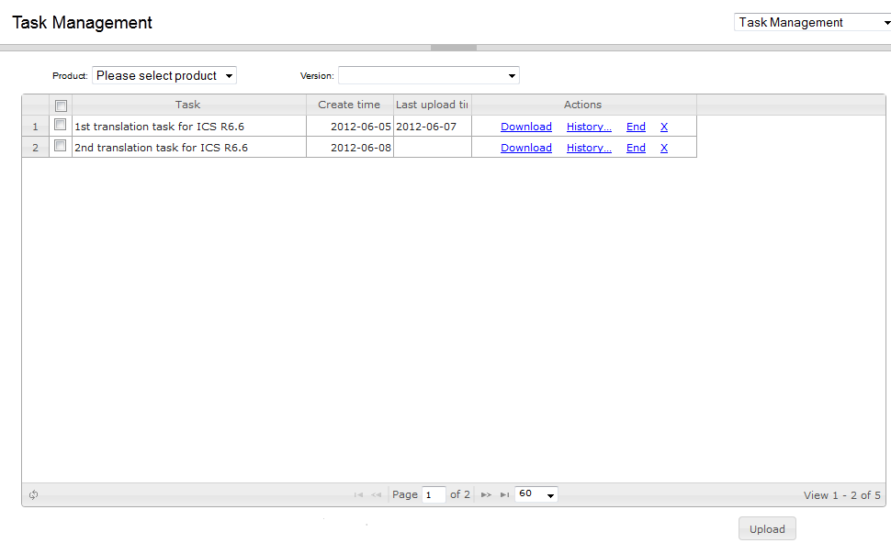
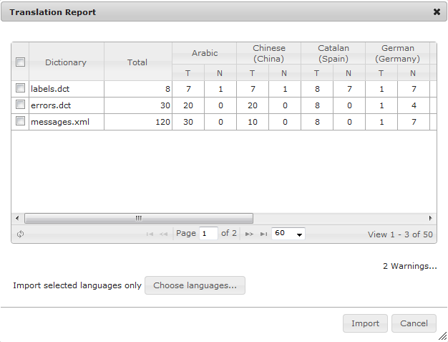
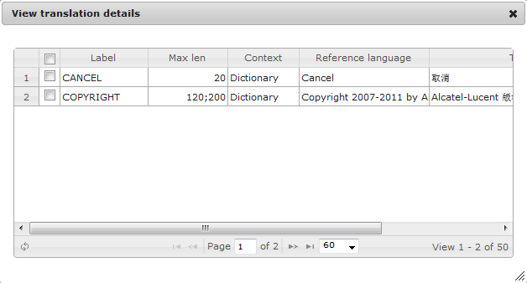
Use Cases
Receive from translation

Slide 20
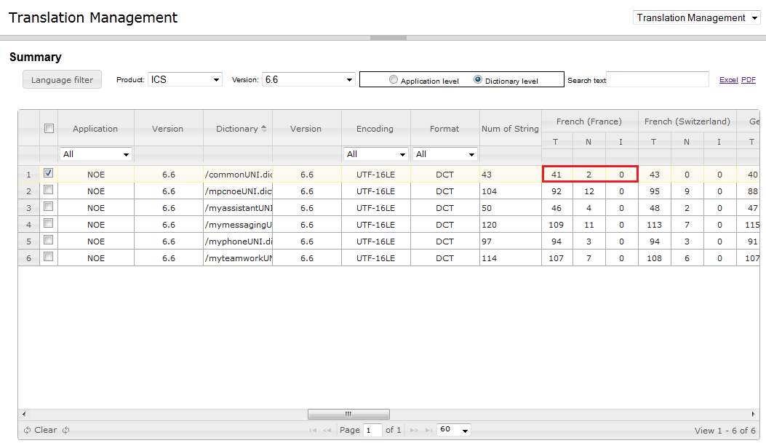
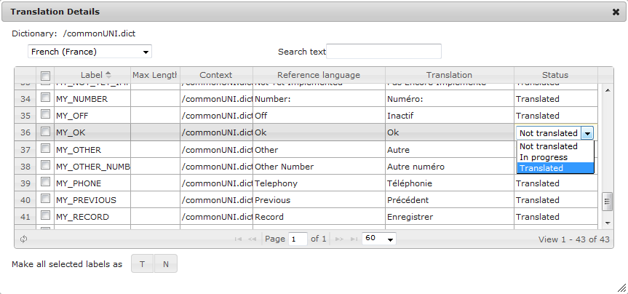
Use Cases
Manage translation status

Slide 21
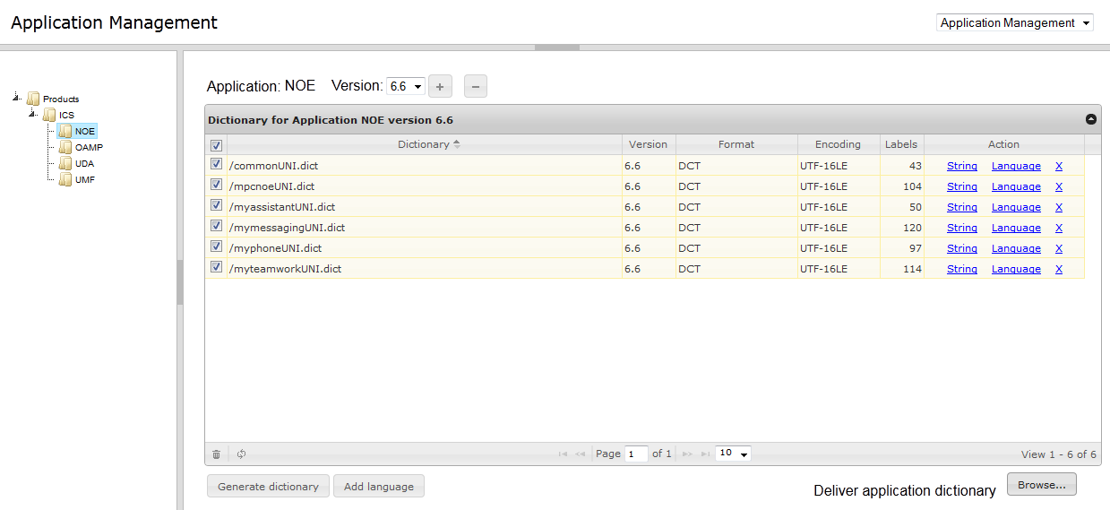
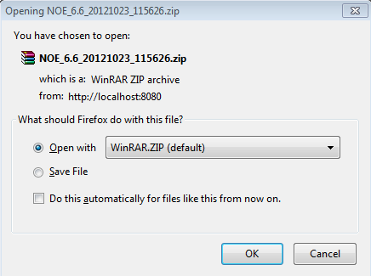
Use Cases
Generate application dictionary

Slide 22
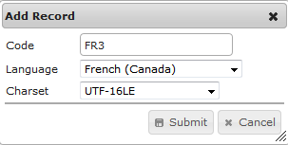
Use Cases
Add new language to dictionary

Slide 23
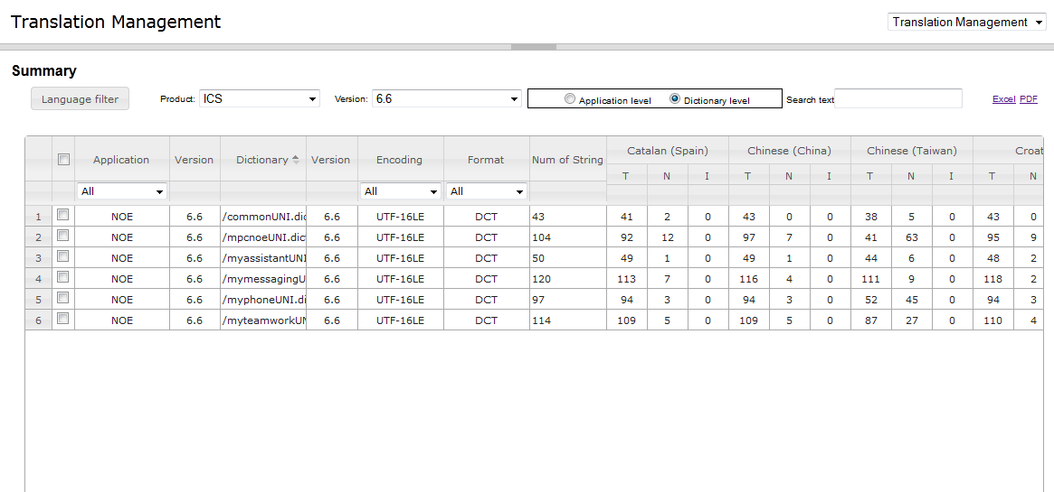
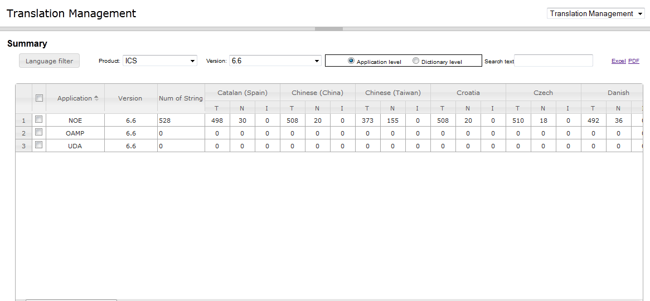
Use Cases
Generate translation reports

Slide 24
DMS Introduction
DMS overview
DMS is a J2EE web application constructed by following framework:
Presentation layer
JSP
Service layer
Struts
Servlet
Data access layer
Hibernate
MySQL
Jersey
jQuery UI

Slide 25
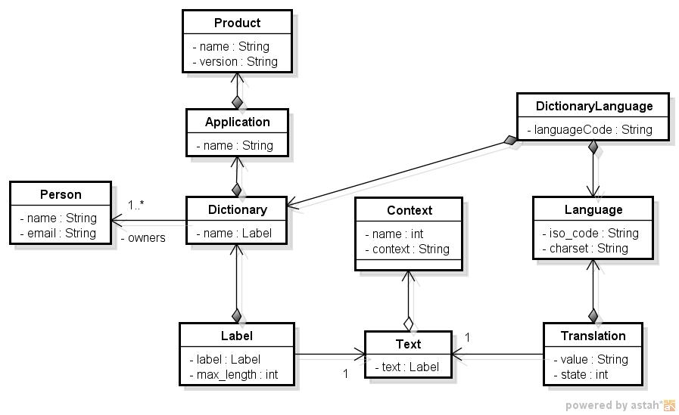
DMS Introduction
Database schema

Slide 26

www.alcatel-lucent.com/enterprise
twitter.com/ALUEnterprise
facebook.com/ALUEnterprise
youtube.com/user/AlcatelLucentCorp

